Slide 1
Java Object Oriented Programming, Class, Class Properties, Objects, New Keyword, Object Creation And Instanceof Keyword
-SAYALI YADAV

Slide 2
Java Object Oriented Programming
Java Object-Oriented Programming (OOP) is a programming paradigm based on the concept of "objects," which contain both data and methods. Java is known for its strong support for OOP principles, and the key features of OOP in Java include:
Classes and Objects
Class: A blueprint for creating objects. It defines a data structure by bundling data (fields or attributes) and methods that operate on the data.
Object: An instance of a class. Objects are created using the new keyword in java
Key OOP Principles in Java:
Encapsulation: Hides internal details, providing control over the data.
Inheritance: Promotes code reuse and hierarchical classification.
Polymorphism: Allows one interface to be used for a general class of actions.
Abstraction: Focuses on essential qualities of an object rather than implementation.

Slide 3
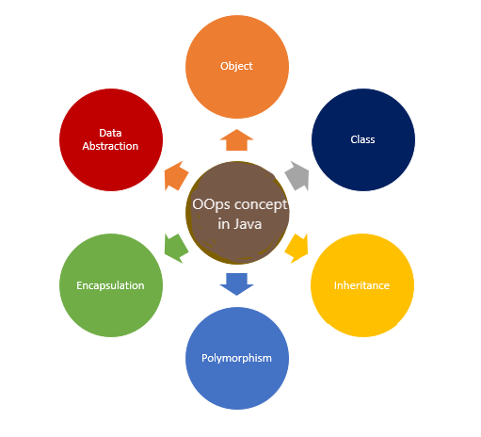

Slide 4
Inheritance
Inheritance allows us to create a new class based on an existing one. The new class, which is called a derived class or subclass, inherits the properties and behaviors of the existing class, called a base class or superclass. It promotes code reuse, modularity, and extensibility.
// Parent class
class Animal {
public void makeSound() {
System.out.println("Animal makes a sound");
}
}
// Child class (inherits from Animal)
class Dog extends Animal {
public void makeSound() {
System.out.println("Dog barks");
}
}
public class Main {
public static void main(String[] args) {
Dog myDog = new Dog(); // Create a Dog object
myDog.makeSound();
}
}

Slide 5
Encapsulation
The definition of encapsulation is "the action of enclosing something in or as if in a capsule". Removing access to parts of your code and making things private is exactly what Encapsulation is all about (often times, people refer to it as data hiding).
Encapsulation means that each object in your code should control its own state. State is the current "snapshot" of your object. The keys, the methods on your object, Boolean properties and so on. If you were to reset a Boolean or delete a key from the object, they're all changes to your state.
class Person {
private String name;
public String getName() {// Public getter method
return name;
}
public void setName(String name) {// Public setter method
this.name = name;
}
}
public class Main {
public static void main(String[] args) {
Person person = new Person();
person.setName("Alice");
System.out.println("Name: " + person.getName());
}
}

Slide 6
Polymorphism
‘Poly’ means ‘many’ and ‘Morph’ means ‘forms’. Polymorphism is the process in which an object or function take different forms. It provides flexibility and extensibility by enabling objects to be used interchangeably and exhibit different behaviors based on their actual type at runtime. It enables method overriding and method overloading.
Public class sample
{
int sum;
void add(int a, int b)
{
sum=a+b;
}
Void add(int a, int b, int c)
{
sum= a+b+c;
}
}
Public static void main(String args[])
{int a,b,c;
sum(10,20);
Sum(10,20,30);
}
}

Slide 7
Abstraction
To abstract something away means to hide away the implementation details inside something – sometimes a prototype, sometimes a function. So when you call the function you don't have to understand exactly what it is doing.
You can create a reusable, simple to understand, and easily changeable codebase by abstracting away certain details. Let me give you an example:
// Abstract class
abstract class Shape {
// Abstract method (no implementation)
public abstract void draw();
}
// Concrete class (extends abstract class)
class Circle extends Shape {
// Implement the abstract method
public void draw() {
System.out.println("Drawing a circle");
}
}
public class Main {
public static void main(String[] args) {
Shape myShape = new Circle();
myShape.draw(); // Calls draw method implemented in Circle
}
}

Slide 8
Class In Java
What is a Class in Java?
A class in Java is a user-defined blueprint or prototype from which objects are created. It represents a real-world entity with attributes (fields) and behaviors (methods). Think of a class as a template, and objects as instances of that template.
[access_modifier] class ClassName [extends SuperClass] [implements Interface1, Interface2, ...]
{
// Class body
}
public class Car
{
// Fields
String brand;
String model;
int year;
}

Slide 9
Classes are the cornerstone of Java's Object-Oriented Programming, enabling developers to model real-world entities with attributes and behaviors. By understanding and effectively utilizing classes, you can create modular, reusable, and maintainable code. Key aspects to remember include:
Structure: Comprising fields, methods, constructors, and possibly nested classes.
Access Control: Using access modifiers to encapsulate data.
Inheritance: Promoting code reuse and establishing relationships between classes.
Abstraction and Polymorphism: Facilitating flexible and scalable code design.
Mastering classes in Java empowers you to build robust applications and harness the full potential of OOP principles.

Slide 10
Class Properties
Class properties in Java can be categorized based on their association with the class itself or its instances.
Instance Variables
Instance variables are properties that belong to individual instances (objects) of a class. Each object has its own copy of these variables.
Characteristics:
Each object maintains its own state.
Static Variables
Static variables, also known as class variables, belong to the class itself rather than any particular instance. They are shared among all instances of the class.
Characteristics:
Defined with the static keyword.
Only one copy exists, regardless of the number of objects created. Accessed using the class name.

Slide 11
Class Properties
Access Modifiers
Access modifiers in Java control the visibility and accessibility of class properties from other parts of the program. The four main access modifiers are:
1) public
Visibility: Accessible from any other class.
Usage: When a property needs to be accessible universally.
2) protected
Visibility: Accessible within the same package and subclasses in different packages.
Usage: When a property should be accessible to derived classes but not universally.
3) private
Visibility: Accessible only within the declared class.
Usage: When a property should be encapsulated and not exposed outside the class.
4) default
Visibility: Accessible only within the same package.
Usage: When a property should be restricted to classes within the same package.

Slide 12
Objects
What Are Objects in Java?
In Java, an object is an instance of a class. It represents a real-world entity with state (attributes or properties) and behavior (methods). Objects are the fundamental units of Java programs, enabling modularity, reusability, and maintainability through the principles of Object-Oriented Programming.
Class | Object
A blueprint or template that defines properties (fields) and behaviors (methods). | An instance of a class that encapsulates actual data and can perform actions.
Does not occupy memory on its own. | Occupies memory when instantiated.
Defines the structure and capabilities. | Represents a specific entity with its own state.

Slide 13
There are many ways to create an object in java. They are: 1)By new keyword 2)By newInstance() method 3)By clone() method 4)By deserialization 5)By factory method etc. Creating object by using new keyword
// Class Definition
public class Dog {
String name;
int age;
void bark() {
System.out.println("Woof!");
}
}
// Creating Objects
Dog dog1 = new Dog();
Dog dog2 = new Dog();
ClassName objectName = new ClassName();

Slide 14
New Keyword
In Java, the new keyword is an operator used to:
Create new objects by allocating memory for instances of classes.
Instantiate arrays by allocating memory for array elements.
Key Points:
The new operator allocates memory on the heap.
It returns a reference to the newly created object or array.
The allocated memory remains until the object is no longer referenced and is eligible for garbage collection.
ClassName objectName = new ClassName();

Slide 15
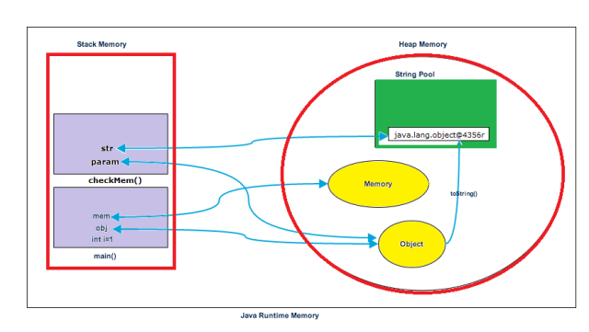

Slide 16
Object Creation And Instanceof Keyword
The java instanceof operator is used to test whether the object is an instance of the specified type (class or subclass or interface).
The instanceof in java is also known as type comparison operator because it compares the instance with type. It returns either true or false. If we apply the instanceof operator with any variable that has null value, it returns false.
class Simple1
{
public static void main(String args[])
{
Simple1 s=new Simple1();
System.out.println(s instanceof Simple1); //true
}
}

